Slide 1
Multiple Barriers Coverage Problem in the Plane
Shimin Li and Haitao Wang
Utah State University
WADS 2017, St. John’s, Canada

Slide 2

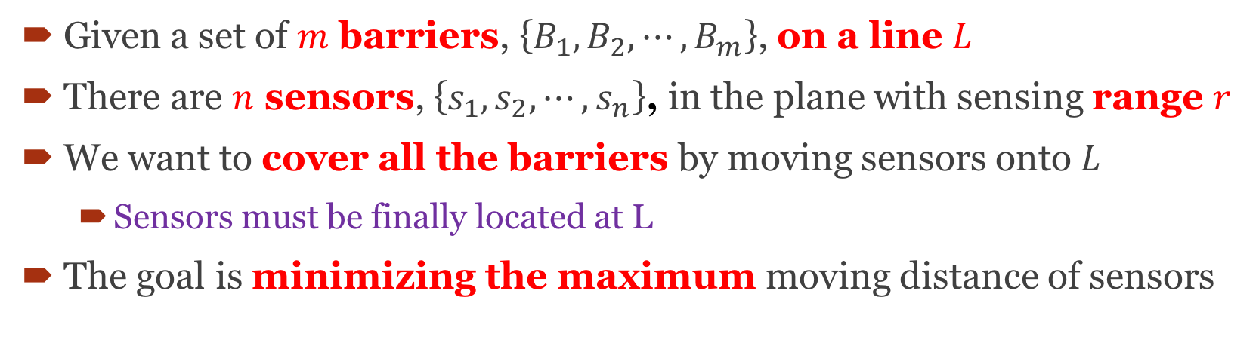



Problem Definition
Given a set of $m$ barriers, $\left\{B_{1},B_{2},⋯,B_{m}\right\}$, on a line $L$
There are $n$ sensors, $\left\{s_{1},s_{2},⋯,s_{n}\right\}$, in the plane with sensing range $r$
We want to cover all the barriers by moving sensors onto $L$
  Sensors must be finally located at L
The goal is minimizing the maximum moving distance of sensors
$$L$$
$$B_{1}$$
$$B_{2}$$
$$B_{3}$$

Slide 3

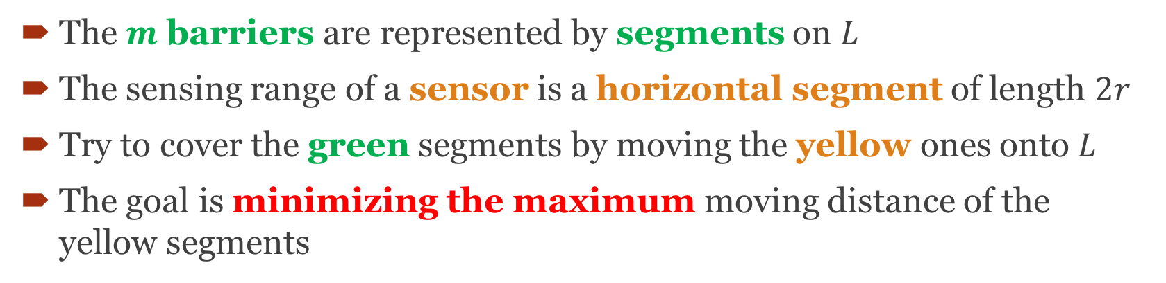
Another Problem View
The $m$ barriers are represented by segments on $L$
The sensing range of a sensor is a horizontal segment of length $2r$
Try to cover the green segments by moving the yellow ones onto $L$
The goal is minimizing the maximum moving distance of the yellow segments
$$L$$
$$B_{1}$$
$$B_{2}$$
$$B_{3}$$

Slide 4
The Line Constrained Case
Sensors are all initially given on L
$$L$$
$$B_{1}$$
$$B_{2}$$
$$B_{3}$$

Slide 5
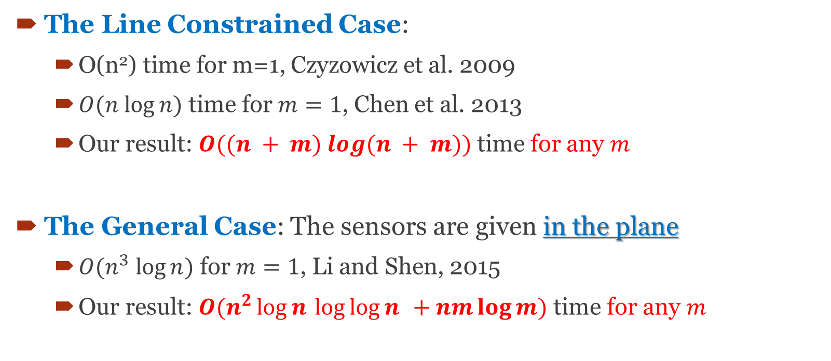
Previous Works and Our Results
The Line Constrained Case:
  O(n²) time for m=1, Czyzowicz et al. 2009
  $O(n log⁡n)$ time for $m=1$, Chen et al. 2013
  Our result: $O((n + m) log⁡(n + m))$ time for any $m$
The General Case: The sensors are given in the plane
  $O(n^{3} log⁡n)$ for $m=1$, Li and Shen, 2015
  Our result: $O(n^{2}\log{n}⁡\log{\log{n}}⁡⁡ + nm\log{m})$ time for any $m$

Slide 6
Outline
The Line Constrained Case
  The algorithm for the decision problem
  The algorithm for the optimization problem
The General Case
  The algorithm for the decision problem
  The algorithm for the optimization problem

Slide 7
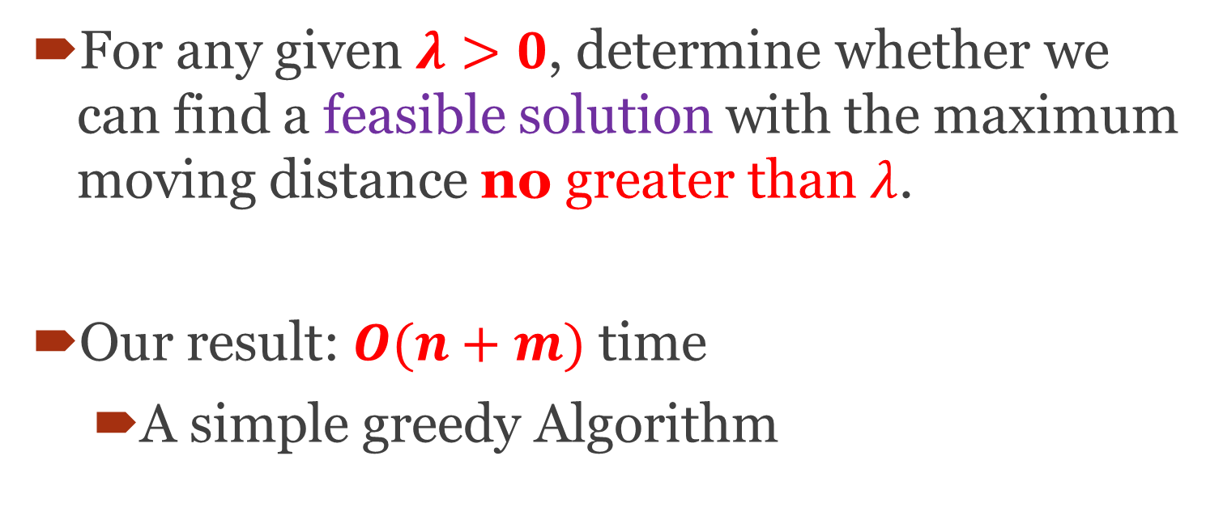
The Decision Problem
For any given $λ>0$, determine whether we can find a feasible solution with the maximum moving distance no greater than $λ$.
Our result: $O(n+m)$ time
  A simple greedy Algorithm

Slide 8
Main Idea
Stage I: Shift all sensors rightwards by 𝜆
Stage II: Move the sensors leftwards one by one as little as possible to cover each barrier from left to right
$$B_{1}$$
$$B_{2}$$

Slide 9
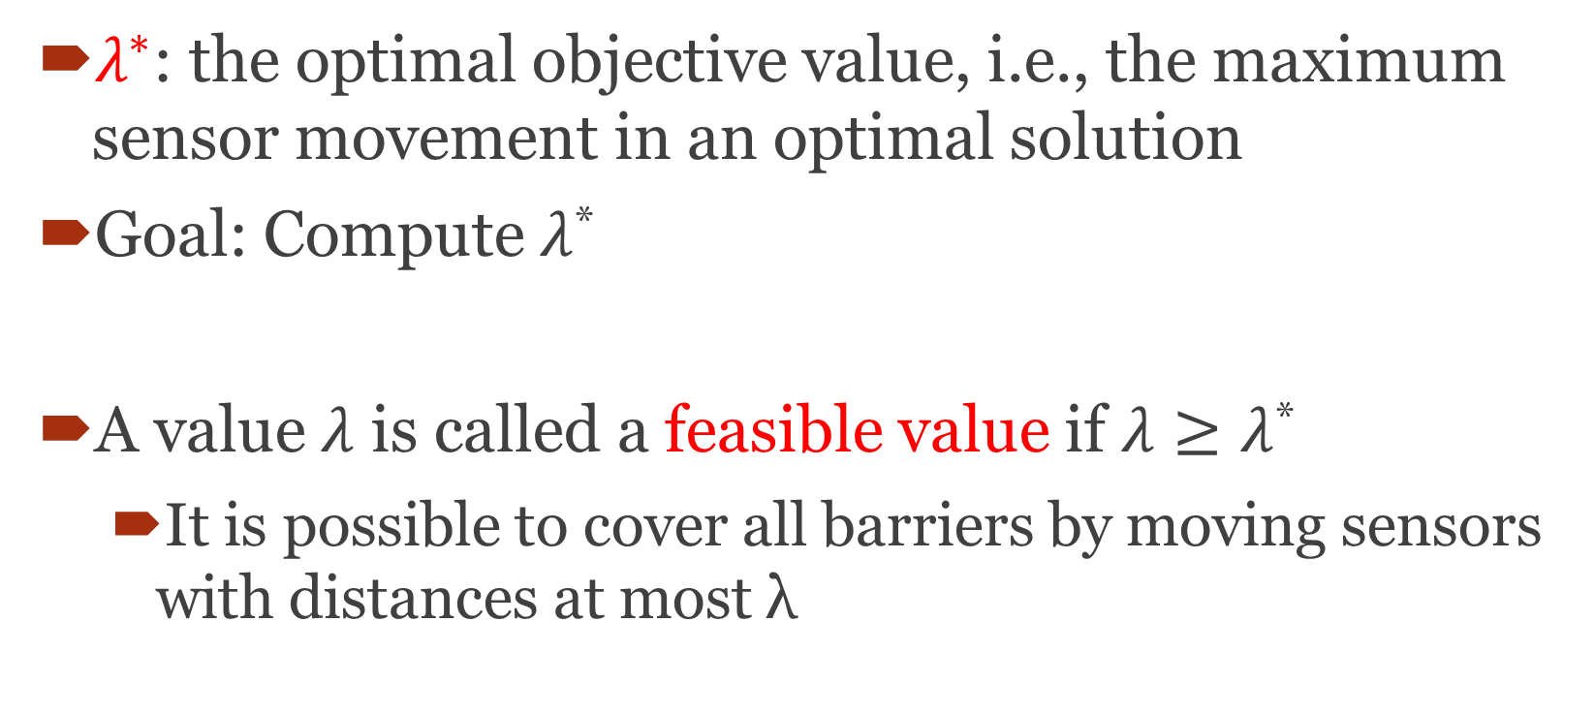
The Optimization Problem
$λ^{∗}$: the optimal objective value, i.e., the maximum sensor movement in an optimal solution
Goal: Compute $λ$*
A value $λ$ is called a feasible value if $λ≥λ$*
  It is possible to cover all barriers by moving sensors with distances at most λ

Slide 10
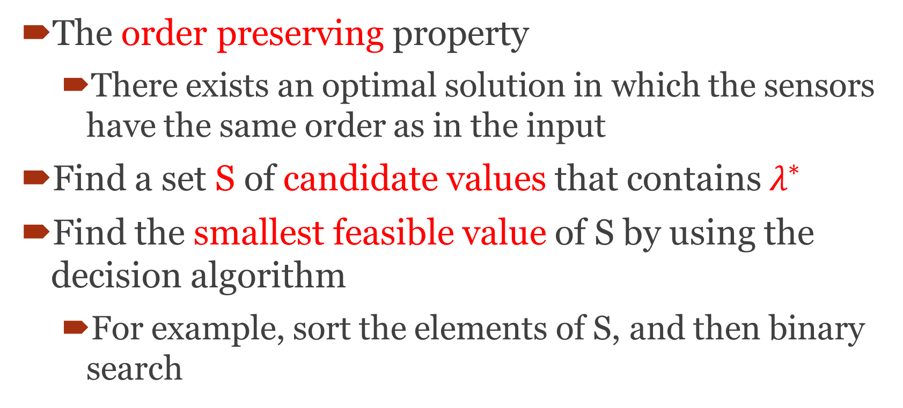
Main Idea
The order preserving property
  There exists an optimal solution in which the sensors have the same order as in the input
Find a set S of candidate values that contains $λ^{∗}$
Find the smallest feasible value of S by using the decision algorithm
  For example, sort the elements of S, and then binary search

Slide 11
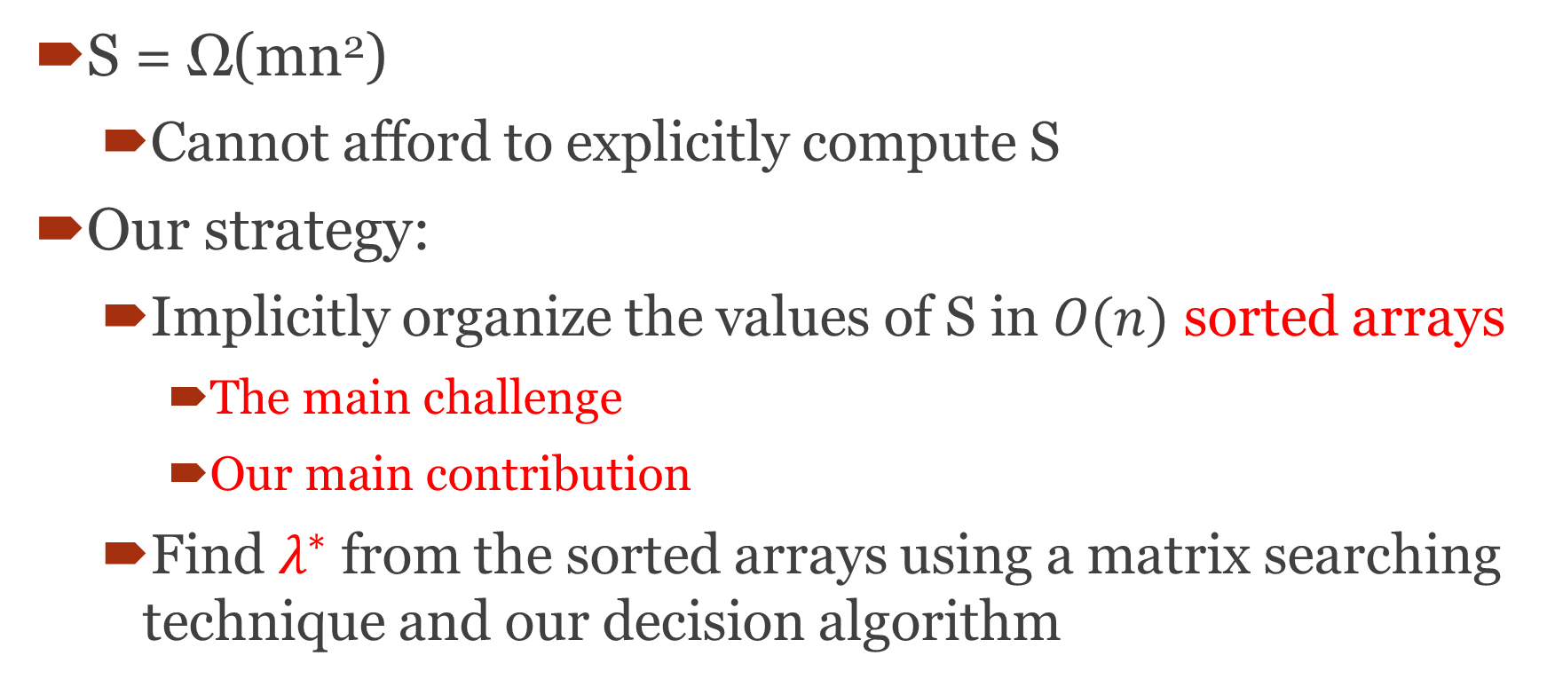
The Difficulty
S = Ω(mn²)
  Cannot afford to explicitly compute S
Our strategy:
  Implicitly organize the values of S in $O(n)$ sorted arrays
    The main challenge
    Our main contribution
  Find $λ^{∗}$ from the sorted arrays using a matrix searching technique and our decision algorithm

Slide 12




Three Optimal Solution Configurations
$$λ^{∗}$$
Case I:
B
$$λ^{∗}$$
Case II:
B
$$λ^{∗}$$
$$λ^{∗}$$
Case III:

Slide 13
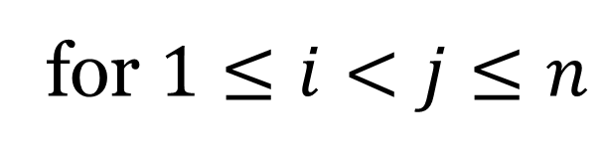
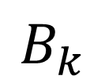
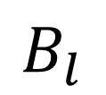
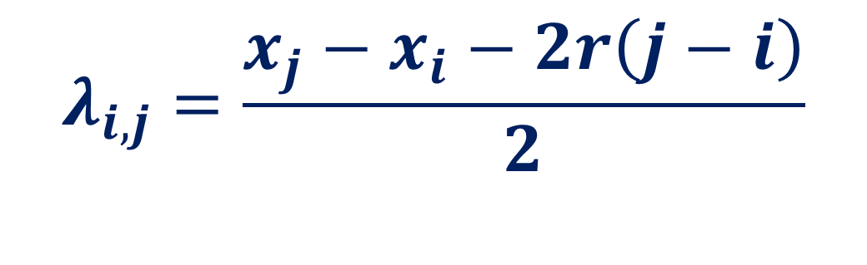


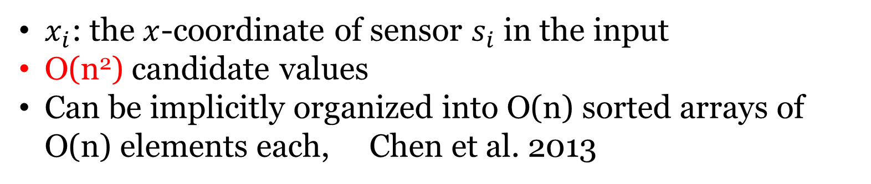
Candidates Values: Case III
λ_{i,j}
λ_{i,j}
$$s_{i}$$
s_{i+1}, s_{i+2}, ……, s_{j-1}
$$s_{j}$$
$$B_{k}$$
$$B_{l}$$
$$λ_{i,j}=\frac{{x_{j}−x}_{i}−2r\left(j−i\right)}{2}$$
for $1≤i<j≤n$
$x_{i}$: the $x$-coordinate of sensor $s_{i}$ in the input
O(n²) candidate values
Can be implicitly organized into O(n) sorted arrays of O(n) elements each, Chen et al. 2013

Slide 14


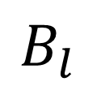
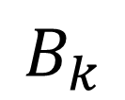
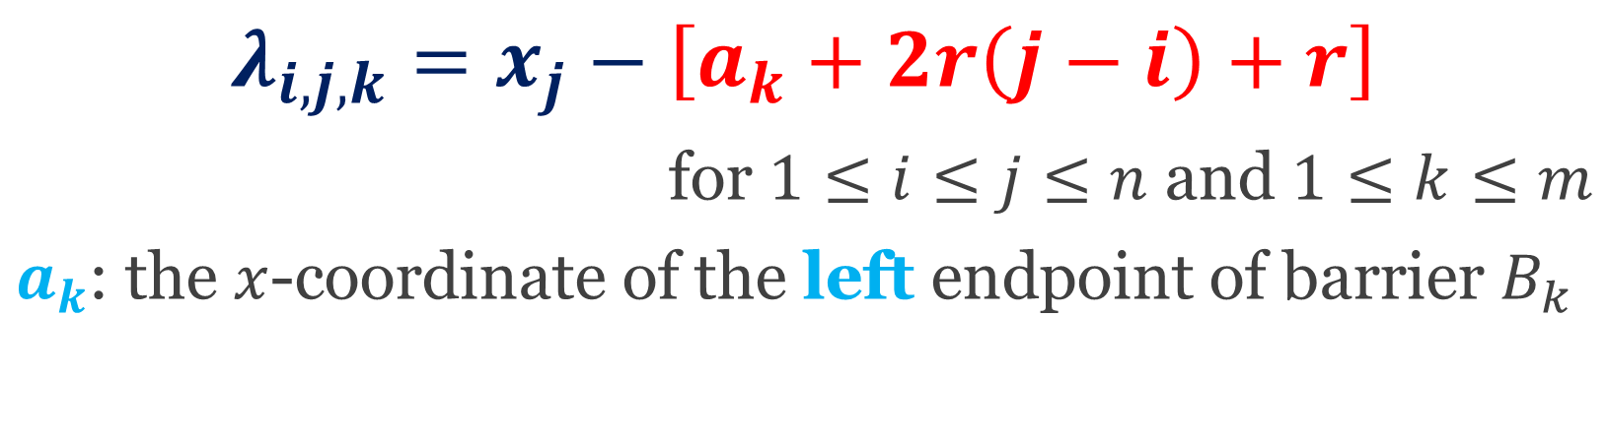

Candidates Values: Case I
λ_{i,j,k}
$$s_{i}$$
s_{i+1}, s_{i+2}, ……, s_{j-1}
$$s_{j}$$
$$a_{k}$$
$$B_{k}$$
$$B_{l}$$
$$λ_{i,j,k}=x_{j}−\left[a_{k}+2r\left(j−i\right)+r\right]$$
for $1≤i≤j≤n$ and $1≤k≤m$
$a_{k}$: the $x$-coordinate of the left endpoint of barrier $B_{k}$
The total number of such candidate values is Θ(mn²)

Slide 15
Candidates Values: Case II
Symmetric to Case I
Our main challenge is on how to organize the Θ(mn²) candidate values for these two cases into sorted arrays
Our result:
In O(m log m) time, we can implicitly form a set of O(n) sorted arrays of O(nm²) elements each such that
  every candidate value is contained in one of these arrays
  each array element can be computed in O(log m) time

Slide 16
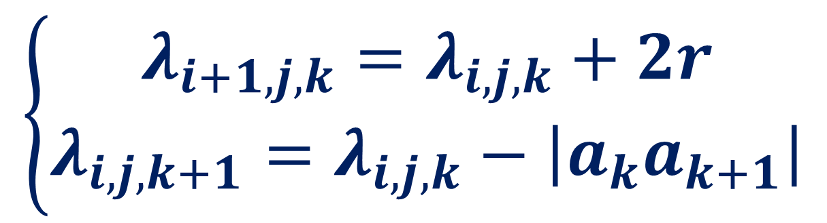
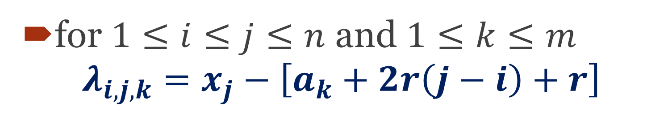
Observations
for $1≤i≤j≤n$ and $1≤k≤m$
$$λ_{i,j,k}=x_{j}−\left[a_{k}+2r\left(j−i\right)+r\right]$$
$$\left\{\begin{aligned}λ_{i+1,j,k}=λ_{i,j,k}+2r \\ λ_{i,j,k+1}=λ_{i,j,k}−\left|a_{k}a_{k+1}\right|\end{aligned}\right.$$

Slide 17
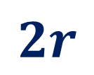
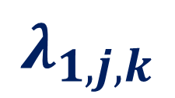

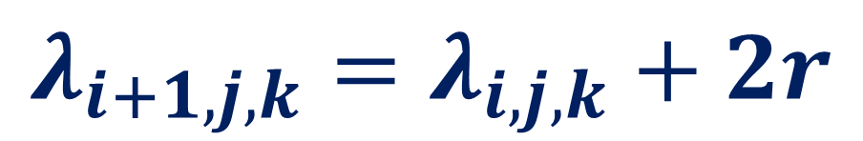

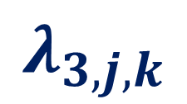

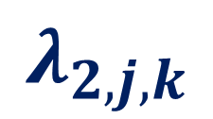

Observations (Cont.)
$$λ_{i+1,j,k}=λ_{i,j,k}+2r$$
$$λ_{1,j,k}$$
$$λ_{2,j,k}$$
$$λ_{3,j,k}$$
$$λ_{j,j,k}$$
$$⋯$$
$$⋯$$
$$2r$$
$$2r$$

Slide 18

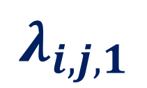

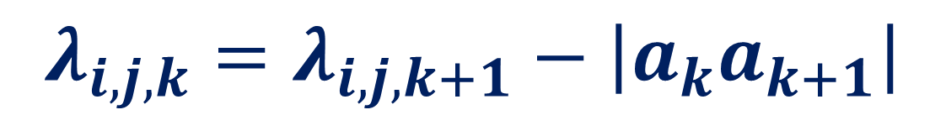

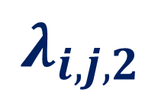
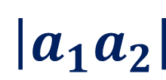
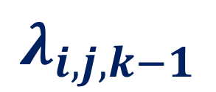
Observations (Cont.)
$$λ_{i,j,k}=λ_{i,j,k+1}−\left|a_{k}a_{k+1}\right|$$
$$λ_{i,j,1}$$
$$λ_{i,j,2}$$
$$⋯$$
$$λ_{i,j,k−1}$$
$$λ_{i,j,k}$$
$$\left|a_{1}a_{2}\right|$$
$$\left|a_{k−1}a_{k}\right|$$

Slide 19
The Line Constrained Case
Time: O((m+n) log(m+n))

Slide 20
The General Case
m barriers on L
n sensors in the plane, each represented by a horizontal line segment of length 2r and the sensor is the midpoint of each segment
$$L$$
$$B_{1}$$
$$B_{2}$$
$$B_{3}$$

Slide 21
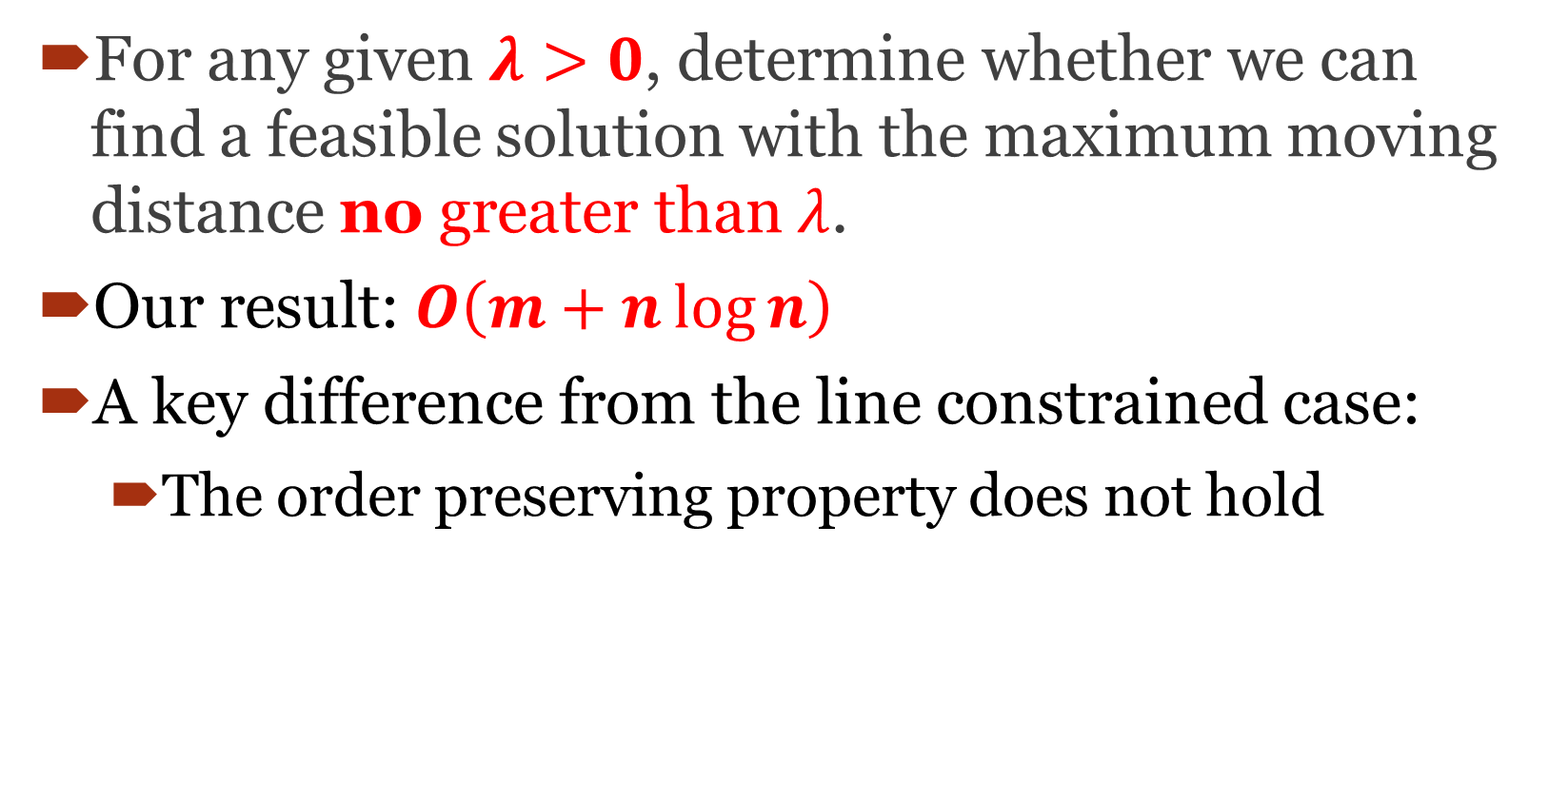
The Decision Problem
For any given $λ>0$, determine whether we can find a feasible solution with the maximum moving distance no greater than $λ$.
Our result: $O\left(m+n\log{n}\right)$
A key difference from the line constrained case:
  The order preserving property does not hold

Slide 22
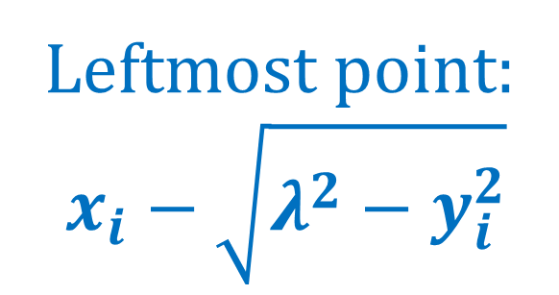


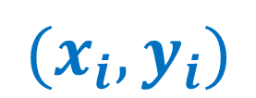


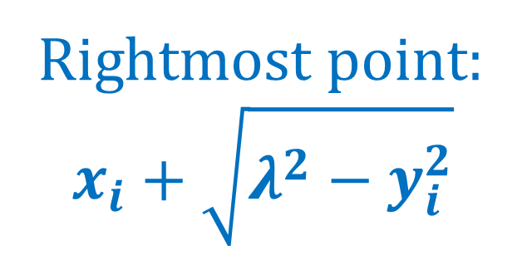
The decision problem: each sensor is allowed to move at most λ
$$s_{i}$$
$$(x_{i},y_{i})$$
$$λ$$
$$λ$$
Leftmost point:
$$x_{i}−\sqrt{λ^{2}−y_{i}^{2}}$$
Rightmost point:
$$x_{i}+\sqrt{λ^{2}−y_{i}^{2}}$$
$$L$$
The moving range of $s_{i}$ on $L$

Slide 23
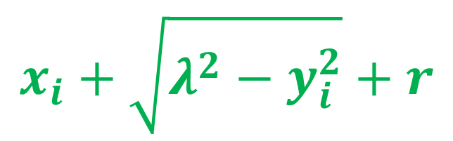






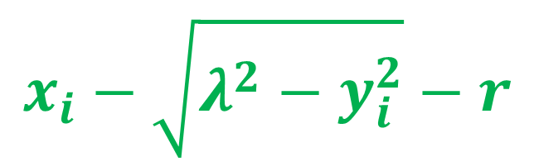
Notation
$$s_{i}$$
$$(x_{i},y_{i})$$
leftmost coverable point
$$λ$$
rightmost coverable point
$$λ$$
$$l_{i}$$
$$r_{i}$$
$$L$$
$$x_{i}−\sqrt{λ^{2}−y_{i}^{2}}−r$$
$$x_{i}+\sqrt{λ^{2}−y_{i}^{2}}+r$$

Slide 24
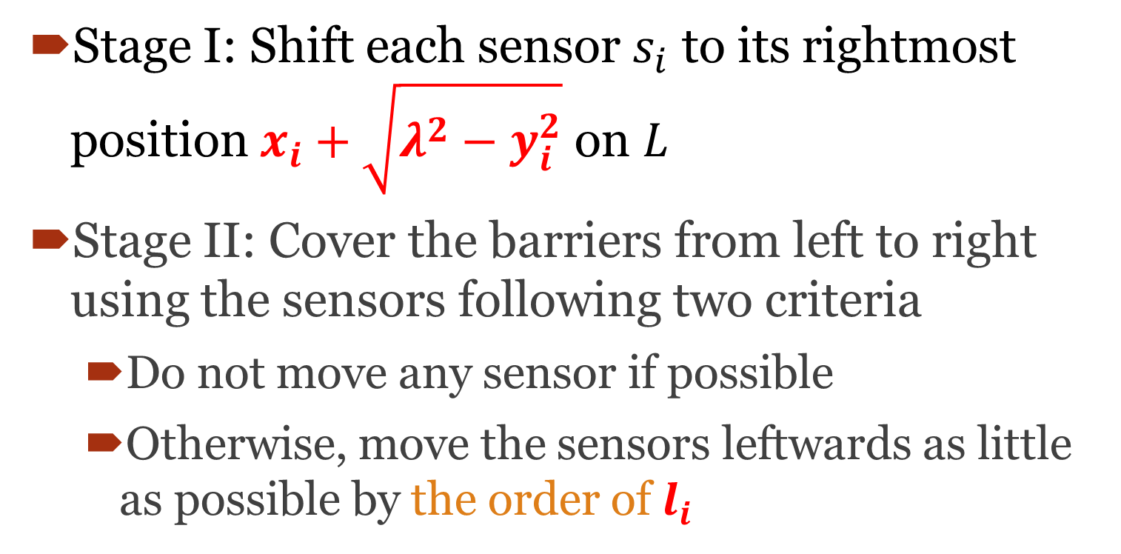
Our Algorithm: Two Stages
Stage I: Shift each sensor $s_{i}$ to its rightmost position $x_{i}+\sqrt{λ^{2}−y_{i}^{2}}$ on $L$
Stage II: Cover the barriers from left to right using the sensors following two criteria
  Do not move any sensor if possible
  Otherwise, move the sensors leftwards as little as possible by the order of $l_{i}$

Slide 25
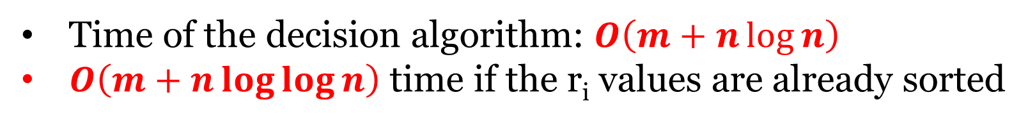
Stage II
Sweep all barriers by a point p on L from let to right
Using appropriate sensors to cover the current point p
$$B_{1}$$
$$B_{2}$$
Time of the decision algorithm: $O\left(m+n\log{n}\right)$
$O\left(m+n\log{\log{n}}\right)$ time if the r_{i} values are already sorted

Slide 26

The Optimization Problem
$λ^{∗}$: the optimal objective value
Goal: Compute $λ$*

Slide 27
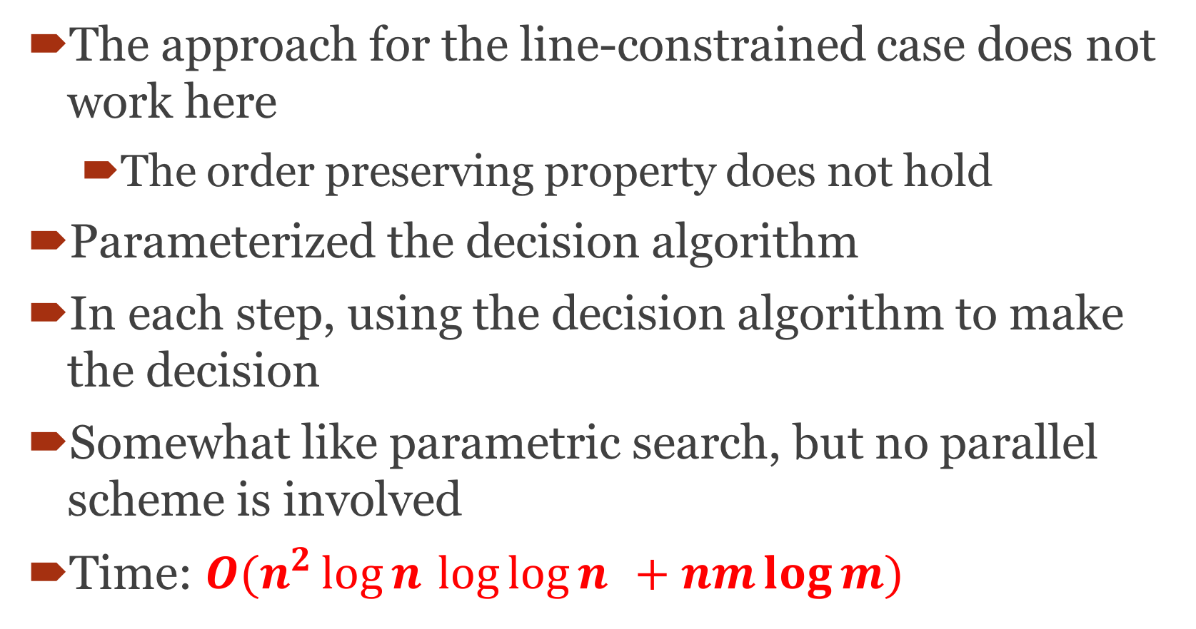
Main Idea
The approach for the line-constrained case does not work here
  The order preserving property does not hold
Parameterized the decision algorithm
In each step, using the decision algorithm to make the decision
Somewhat like parametric search, but no parallel scheme is involved
Time: $O(n^{2}\log{n}⁡\log{\log{n}}⁡⁡ + nm\log{m})$

Slide 28
Thanks!

